Slide 1
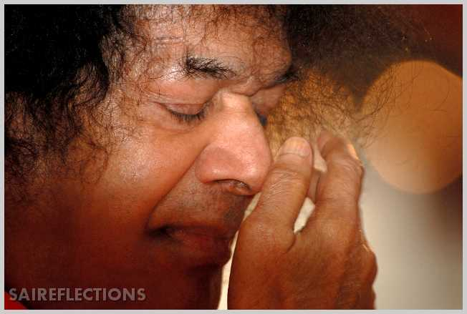
Offering at the lotus feet

Slide 2

ARM SIMULATOR

Slide 3

PROBLEM STATEMENT
To create an ARM Simulator which performs basic arithmetic, LOAD and STORE operations.

Slide 4
INTRODUCTION
ARM processors are made by the ARM holdings PLC.
RISC (Reduces Instruction Set Computing) .
simple processing unit producing a high quality for the users.
There are only 25 basic instruction types in this designed processor.
All instructions have some condition on them.
This project is a simple ARM Simulator which performs only arithmetic, Load and Store operations.

Slide 5
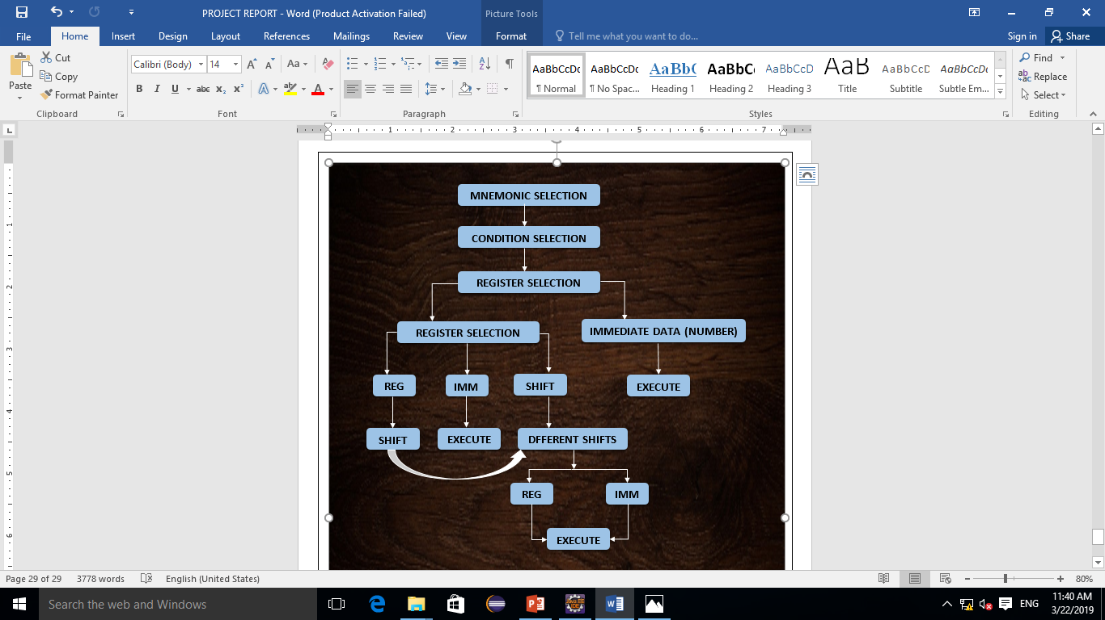
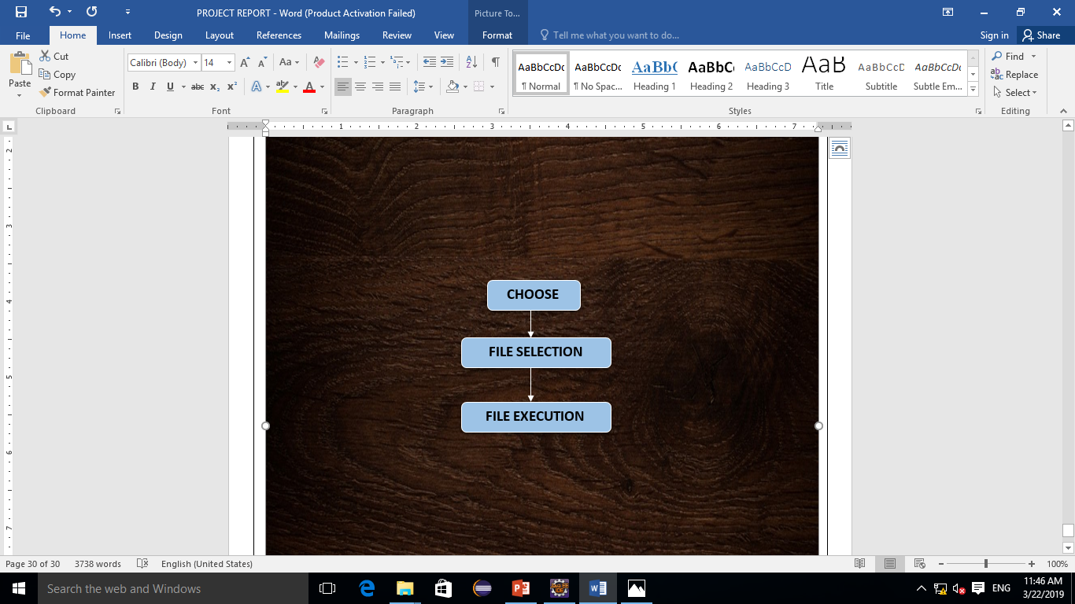
NORMAL EXECUTION
FILE EXECUTION

Slide 6
Normal Execution Functionalities:
The user is made sure that he/she doesn’t enter an instruction that doesn’t fall under the ARM Instruction Set.
On hover over an element a popup appears explaining the functionality of the particular instruction.
User has an option of deleting the mnemonic by clicking the back button.
On execution of an instruction the instruction table (list of instructions that has been executed till that point) pops up.
If the conditional execution fails, there will be an alert informing that the instruction has not been executed.

Slide 7
File Execution Functionalities:
The simulator accepts only files of .txt format.
The instructions have to be written in the way as mentioned
MOV, NE, R0, #100
MOV, NE, R1, R0
ADD, AL, R2, R0, R1
#
In the above code each mnemonic and its operands are succeeded with comma and a space (, ) except the last one.
The end of file is recognized with (#).
All the instructions in the file must be uppercase.
The immediate value must be preceded with (#).
By clicking the choose button in the simulator, the option for selecting files gets opened and on clicking at the file, it gets executed.
If the conditional execution fails, there will be an alert informing that the instruction has not been executed.

Slide 8
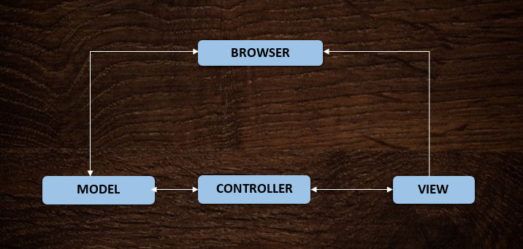
ARCHITECTURE
MVC can be used if
The same data is being rendered in different ways on the page
Your application has many trivial interactions that modify data (buttons, switches)
Much of the viewing or manipulation of data will be within the browser rather than on the server

Slide 9
DESCRIPTION OF FUNCTIONS IN FRONT.js

Slide 10
NAME OF THE FUNCTION | DESCRIPTION ABOUT THE FUNCTION
mnemonicPage() | Displays the mnemonic operations available.
mnemonic(ins) | This function takes ins as a parameter and it contains the mnemonic name. This function is called when the mnemonic is clicked. It writes the mnemonic (ADD,LDR/MUL….) in the instruction panel and creates a track.
changeToConditional(mcins) | This function takes mcins as a parameter and it contains the instruction that is to be displayed in the instruction panel. This function is called by the mnemonic(). It displays the conditional execution instructions.
condition(condition) | This function takes condition as a parameter and it contains the conditional execution mnemonic that’s been clicked by user. This function is called when the condition is clicked. It writes the condition(NE/EQ/AL….) in the instruction panel and creates a track.
changeToRegister() | This function is called by the condition(). It displays the Register set.
register(register) | This function takes register as a parameter and it contains the register name. This function is called when a Register is clicked. It writes the register (R0/R1…) in the instruction panel and creates a track. This function plays an important role in directing user in a proper of entering the instruction.

Slide 11
shifter(mcins) | This function takes mcins as a parameter which contains the instruction that’s to be written in the instruction panel. This function is called by the register().This displays the button of shifter.
changeToShifter() | This function is called when the shifter button is clicked. This function displays different shifts available. (LSL/ASR…).
shifterValues(shif) | This function takes shif as a parameter it contains the type of shifter that’s been chosen by the user. This function gives the option for the user to decide whether the shifter value is an immediate value or a value from the register.
changeToNumAndReg() | This function displays two buttons NUMBER, REGISTER.
changeToNumRegAndShift(mcins) | This function takes mcins as a parameter which contains the instruction that’s to be written in the instruction panel. This function displays three buttons NUMBER, REGISTER, SHIFTER.
changeToNumber() | This function allows the user to enter the number that he wishes to store in a register. This function goes through validation where it accepts only numeric values.

Slide 12
ChangeToAddress() | This function allows the user to enter an address where the value of the register specified in the instruction will be stored. This function goes through validation where it accepts only numeric values.
openFile(event) | This function takes in event as a parameter which is created onclick of choose button. This function gets invoked when the user wants to execute a file by clicking the CHOOSE option in the simulator.
number(num) | This function takes num as a parameter which contains the number entered by the user. This function adds the number to instruction panel and modifies the track.
address(addr) | This function takes addr as a parameter which contains the address entered by the user. This function adds the address entered by the user to instruction panel and modifies the track.
back() | This function gets invoked when the BACK button is clicked in the simulator. This removes the last word in the instruction panel and removes the last word in the track. EXAMPLE: ADD, EQ, R0 onclick of BACK button the instruction panel become ADD, EQ, . The track becomes M01, C00, from M01, C00, R.

Slide 13
clr() | This function gets invoked when the CLEAR button is pressed in the simulator. This clears the whole instruction that is present in the instruction panel an d calls the mnemonicPage() function which displays the mnemonic operations available.
validation(num) | This function takes num as parameter which contains a number entered by user.This function gets called when an address or a number is entered. This does a validation where it allows only numeric values to be entered.
removePopover() | Since the popover of the elements are activated on hover. Onclick of an element activates the popover and it doesn’t get removed. To solve this problem, the element is captured by its class name and is removed in the next function.
tour() | This function is a kind of reminder for the user who uses the simulator. This gets called onload() of the body. This displays the Do’s and Don’ts of the simulator.

Slide 14
DESCRIPTION OF FUNCTIONS IN DIRECTING.js

Slide 15
NAME OF THE FUNCTION | DESCRIPTION ABOUT THE FUNCTION
executeFile(ARM) | This function takes a parameter called ARM which is a string array. This variable contains the instruction that’s present in the file. This function first creates the track for each instruction and directs each instruction to the direct() function. On successful execution of the file there will be an alert indicating the file has been executed successfully.
createTrack(ARM[i]) | This function takes a parameter called ARM[i] which is a string, which contains instruction. There is a kind of unique code for each part of the instruction. The instruction is executed by recognizing this code. In manual execution onclick of each button the track is created. In file execution track is not created therefore this function creates the track for the instruction.
direct() | This is a main function in the simulator which directs to different functions. It checks the conditional execution by calling checkExecution(), it fetches the register values by calling getRegisterValue(), does a shift modification by calling shift(), last it passes the operands the mnemonic function().
operands(ltrack, lword) | The parameters ltrack and lword are the particular unique code and the mnemonic for that code respectively. This function differentiates between register and immediate operands returns the value of it.

Slide 16
getRegisterValue(lword) | The parameter lword contains the part of instruction. In this case it contains the register (R0, R1, …). This function using document. getElementById () accesses the GPR table and fetches the value of the particular register mentioned.
shift(track, word) | The parameters track and word is a string which contains the unique code for the whole instruction and the whole instruction respectively.
mnemoniCall(ltrack, val1, val2) | After fetching the operand values this function directs the values and the operation unique code to the respective mnemonic function. ADD (ltrack, val1, val2). The parameters ltrack is the unique code for the mnemonic operation, val1 and val2 are the two operands for the operation.
writeToTable(val, word) | This function takes the value that is to be written to the register and the register to which it is to be written. This function accesses the GPR table and write the value to the particular register mentioned.
checkExecution(cond) | This function takes cond as parameter which is the conditional execution instruction. This function checks the condition of the conditional execution with the flag registers.

Slide 17
DESCRIPTION OF FUNCTIONS IN MNEMONIC_FUNCTIONS.js

Slide 18
NAME OF THE FUNCTION | DESCRIPTION ABOUT THE FUNCTION
addIns(ins) | This functions takes instruction that’s to be executed as its parameter. It writes the instruction in the instruction table and it is called by the direct() function.
addRow(ins) | This functions takes instruction that’s to be executed as its parameter. It writes the instruction in the GPR table and creates a row of the general purpose registers.
ADC(n1, n2) | This function takes in n1 and n2 as its parameters which contains the values of register. This function performs ADDITION WITH CARRY operation where it adds the values of two operands and adds the value of carry flag to the result. According to the result the flag registers are updated.
ADD(n1, n2) | This function takes in n1 and n2 as its parameters which contains the values of register. This function performs ADDITION operation where it adds the values of two operands. According to the result the flag registers are updated.
AND(n1, n2) | This function takes in n1 and n2 as its parameters which contains the values of register. This function performs BITWISE AND operation where it does the AND operation for each bit. According to the result the flag registers are updated.
BIC(n1, n2) | This function takes in n1 and n2 as its parameters which contains the values of register. The second variable is passed to NOT () function and the BITWISE AND operation is performed with the modified value. According to the result the flag registers are updated.

Slide 19
EOR(n1, n2) | This function takes in n1 and n2 as its parameters which contains the values of register. EOR (Exclusive OR) operation is performed between these two operands. According to the result the flag registers are updated.
MOV(n1) | This function takes in n1 as its parameter which contains an immediate value or value of a register. This function performs a MOVE operation. According to the value of n1 flag registers are updated.
MVN(n1) | This function takes in n1 as its parameter which contains an immediate value or value of a register. Since the operation MOVE NOT the operand is passed to NOT () function. According to the value of n1 flag registers are updated.
ORR(n1, n2) | This function takes in n1 and n2 as its parameters which contains the values of register. This function performs BITWISE OR operation where it does the OR operation for each bit. According to the result the flag registers are updated.
RSB(n1, n2) | This function takes in n1 and n2 as its parameters which contains the values of register. This function performs REVERSE SUBTRACTION (n2-n1). According to the result the flag registers are updated.
RSC(n1, n2) | This function takes in n1 and n2 as its parameters which contains the values of register. This function performs REVERSE SUBTRACTION WITH CARRY. First (n2-n1) is performed, later the carry flag is subtracted from (n2-n1). According to the result the flag registers are updated.

Slide 20
SBC(n1, n2) | This function takes in n1 and n2 as its parameters which contains the values of register. This function performs SUBTRACTION WITH CARRY. First (n1-n2) is performed, later the carry flag is subtracted from the result of (n1-n2). According to the result the flag registers are updated.
SUB(n1, n2) | This function takes in n1 and n2 as its parameters which contains the values of register. This function performs SUBTRACTION of two operands (n1-n2). According to the result the flag registers are updated.
TEQ(n1, n2) | This function takes in n1 and n2 as its parameters which contains the values of register. This function performs BITWISE EOR (Exclusive OR). The difference between EOR() and TEQ() is the result is not written to the destination register but according to the result the flag registers are updated.
TST(n1, n2) | This function takes in n1 and n2 as its parameters which contains the values of register. This function performs BITWISE AND. The difference between AND () and TST () is the result is not written to the destination register but according to the result the flag registers are updated.
CMN(n1, n2) | This function takes in n1 and n2 as its parameters which contains the values of register. This function performs ADDITION. The difference between ADD() and CMN() is the result is not written to the destination register but according to the result the flag registers are updated.
CMP(n1, n2) | This function takes in n1 and n2 as its parameters which contains the values of register. This function performs SUBTRACTION. The difference between SUB() and CMP() is the result is not written to the destination register but according to the result the flag registers are updated.

Slide 21
MUL(n1, n2) | This function takes in n1 and n2 as its parameters which contains the values of register. This function performs multiplication of two numbers. According to the result the flag registers are updated.
LDR(reg, saddr) | This function takes in reg and saddr as its parameters which contains the values of register and address respectively. If the address mentioned is not present in STACK TABLE, then an ERROR alert pop’s up by mentioning illegal access of memory. According to the value of the register the flag value is updated.
STR(reg, saddr) | This function takes in reg and saddr as its parameters which contains the values of register and address respectively. If the address mentioned is not present in STACK TABLE, then the address and its value is added to the table, else the value is rewritten on that address value. According to the value of the register the flag value is updated.
NOT(num) | This function takes a register value as it’s parameter and does a NOT () operation on it. All the 1’s are changed to 0 and 0’s to 1.
Decbin(dec, length) | This function takes in dec and length as it’s parameters which contains register value and the length of the binary representation of the register value. It converts a decimal number to binary of the length mentioned and returns the binary value.
binDec(binary) | This function takes in binary as it’s parameters which contains a binary value. It converts the binary to its decimal equivalent.

Slide 22
LIMITATIONS
Validation for file execution is not done.
Since onchange() is given for file execution, files of same name can’t be executed consecutively.
Since the project is client side dependent the F5 button has been disabled but the browser refresh/reload button is not.
The project can be used only after knowing some basics of Assembly language and basics of Microprocessor.
Because of the browser the popup sometimes might not get cleared.

Slide 23
FUTURE SCOPE
This simulator just performs basic arithmetic, load and store operations. In future some more operations can be included.
Loops and subroutines can be added.
Register pair operations can be performed.
Machine cycle, Instruction cycle, and T-states can be added to the simulator.
The simulator can be made more user friendly.
Further Addressing Modes can be added.

Slide 24

THANK YOU
164406
164414

